Slide 1
Workshop #3: CSS continued

Slide 2
Today’s agenda…
More on advanced selectors!
Learn commonly used and useful CSS properties
Connecting HTML and CSS

Slide 3

CSS
Applies styles to sites
Works in relation with HTML
ul {
list-style-type: none;
margin: 0;
padding: 0;
}
li {
display: inline;
padding: 0 0 1rem 1rem;
}
a {
text-decoration: none; color: #000000;
}
Before CSS
After CSS

Slide 4
Writing CSS
Selectors -> Properties
Selectors can be HTML elements, classes or IDs.
CSS is divided into classes. These are NOT the same as HTML ‘classes
ul {
list-style-type: none; margin: 0;
padding: 0;
}
#my-element-id {
background-color: #000000;
}
.my-element-class {
text-decoration: none; color: #000000;
}

Slide 5
CSS Class Breakdown
Selector. ‘.’ for HTML class
.my-element-class {
text-decoration: none; color: #000000;
}
Properties to change

Slide 6
Advanced selectors
Further narrow down your selections
.my-element-class ul { list-style-type: none; margin: 0;
padding: 0;
}
#my-element-id:hover {
background-color: #000000;
}
.my-element-class:active { text-decoration: none; color: #000000;
}

Slide 7
Advanced selectors: Pseudo-classes
‘Pseudo-class’
#my-element-id:hover {
background-color: #000000;
}
.my-element-class:active {
text-decoration: none;
color: #000000;
}

Slide 8
Advanced selectors: Grouping
HTML element selector
.my-element-class p {
background-color: #000000;
}
.my-element-class a {
text-decoration: none;
color: #000000;
}

Slide 9
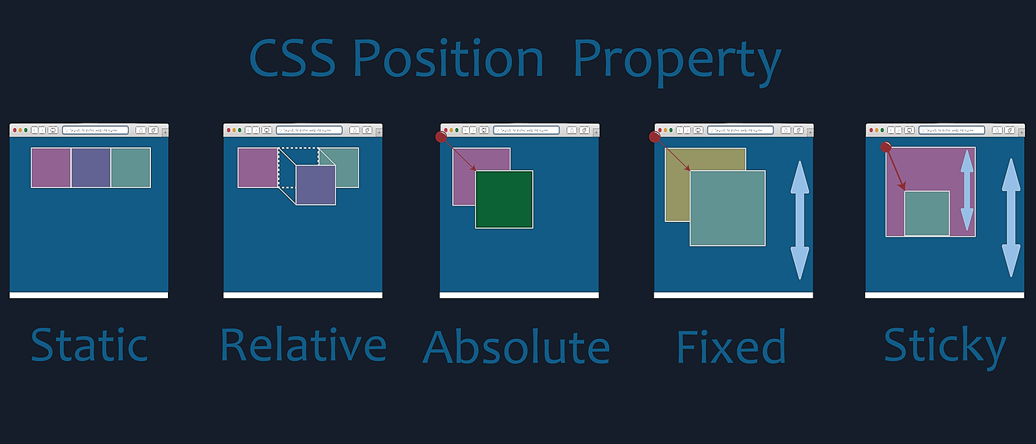
Intro to CSS properties: Position
Control the placement of an element

Slide 10
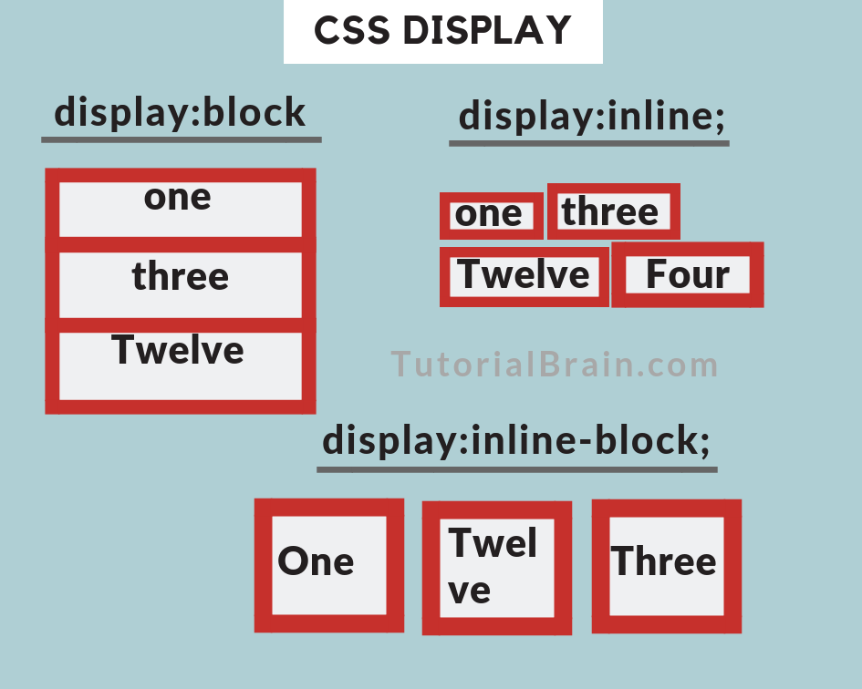
Basic CSS properties: Display
Used to change the way things are positioned on a page

Slide 11
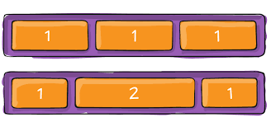
Basic CSS properties: Display: flex
The most useful and versatile display
Control directional flow, and size distribution of content

Slide 12
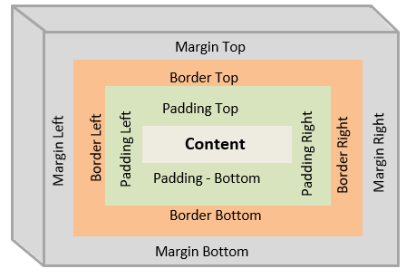
Intro to CSS properties: Spacing
Control spacing between and within elements using margin, border and padding

Slide 13
Connecting HTML & CSS
🙂
😇
Method #1:
External file
<link rel="stylesheet" href="styles.css">
<style>
.my-element-class {
color: white;
}
</style>
🙂
Method #2:
Style HTML tag
😤
Method #3:
Inline
<button style="color:black">Add To Bag</button>

Slide 14
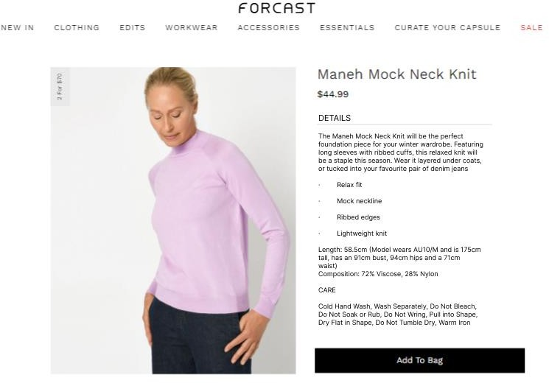
Activity: Forcast’s new PDP Part 2

